Slide 1
1,900,000,000
People are overweight!
Institute for Health Metrics and Evaluation University of Washington

Slide 2
Deaths
Diet Related > Smoking
Institute for Health Metrics and Evaluation University of Washington

Slide 3
Why not eat healthy?
Convenience
Cost
(time to) Cook

Slide 4

Would you rather?
Healthy options. Anytime. Anywhere.

Slide 5
Would you rather?
Healthy options. Anytime. Anywhere.

Slide 6
Would you rather?
Healthy options. Anytime. Anywhere.

Slide 7
Would you rather?
Healthy options. Anytime. Anywhere.

Slide 8
How do we make money?
Through affiliate links used by our customers.
Monetary partnership with grocery stores.
Partner up with culinary websites.

Slide 9
Competitors
 | Would you rather? | HelloFresh | WeCook
Choice | Wide variety of choices | Limited choices every week. | Limited choices every week.
Cost | Same as market | Marked up | Marked up
Logistics | Handled by others (Instacart, Walmart) | Self-handled | Self-handled
Availability | Widely available | Limited | Limited
Expandability | Easy | Hard | Hard

Slide 10
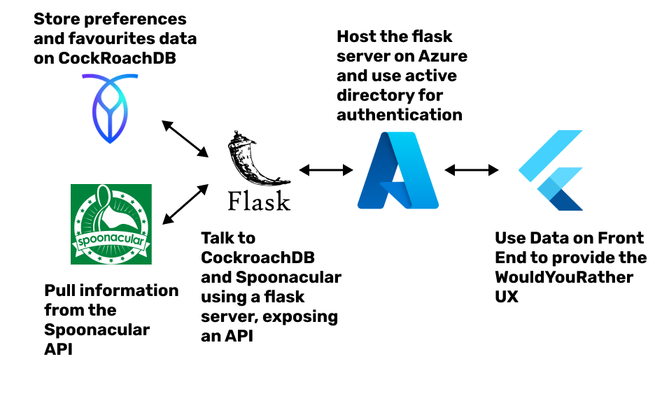
Competitors
Technologies

Slide 11
Eat Healthy!

